Slide 1
Nano learning: Design Patterns
The Bridge

Slide 2
What is the bridge design pattern
A structural design pattern: structural design patterns simplify and help to rationalise relationships between entities in an OO system.
Decoupling abstraction from their implementation, allowing other objects and classes to access functionality but remain “dumb” to the specifics of the implementation process.

Slide 3
What problem does this solve?
Hardening of software arteries: systems become “hard”, inflexible to change, leading to bloating etc.
The easier sharing/replacing of existing/new implementations among multiple objects.

Slide 4
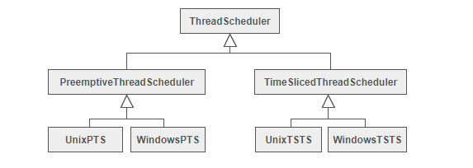
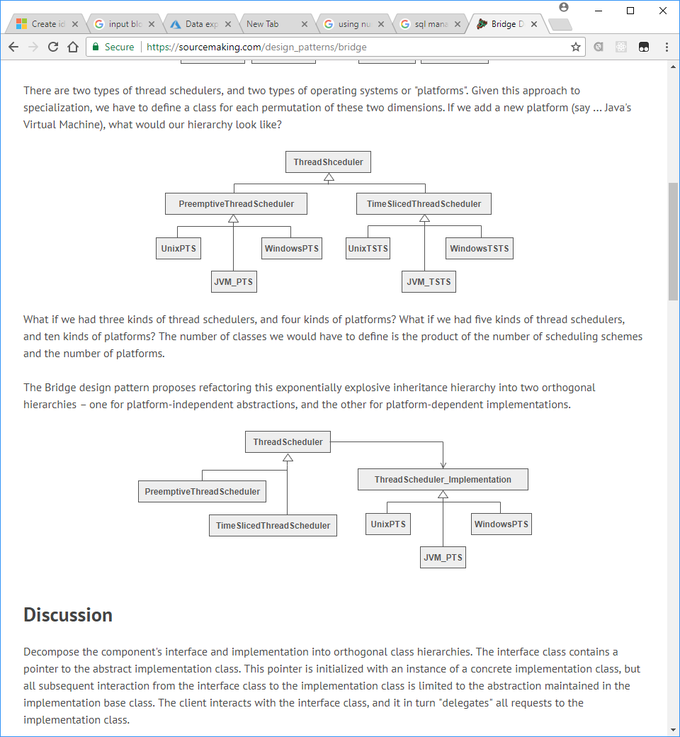
What problem does this solve?
Hardening of software arteries: systems become “hard”, inflexible to change, leading to bloating etc.
The easier sharing/replacing of existing/new implementations among multiple objects.

Slide 5
How does it solve this problem?
Orthogonal (parallel) hierarchies: two connected class hierarchies working in unison

Slide 6

Real world analogies

Slide 7
Real world analogies
Shape
Rectangle
Circle
Blue rectangle
Red rectangle
Red circle
Blue circle

Slide 8
Real world analogies
client
color
Shape
(color)
Rectangle
Circle
Blue
Red

